Slide 1

Customer Purchase Analysis
NAME: Darshan DATE: June 2025

Slide 2
INTRODUCTION
Objective
Problem Statement
To analyze customer purchasing behavior across multiple product categories and derive actionable insights for improving customer engagement, retention, and sales performance.
The business lacks clarity on which customer segments are driving sales, returning products, or churning. High return rates (~50%) and no clear category dominance make it difficult to target marketing or optimize product strategies effectively.
Goal
Identify key trends in purchasing, churn, and return behavior
Enable real-time, personalized product recommendations for enhanced user experience

Slide 3
PROJECT PROCESS
Data Cleaning & Processing
Removed duplicates, handled missing values, and standardized data types.
Encoded categorical variables and normalized numerical features for analysis
Exploratory Data Analysis(EDA)
Visualized purchase trends, return patterns, churn behavior, and demographic distributions.
Analyzed spending patterns by gender, age, and product category.
Data Sources
1. Data Collection
Gathered customer transaction data, including demographics, purchase details, product categories, return status, and payment methods.

Slide 4
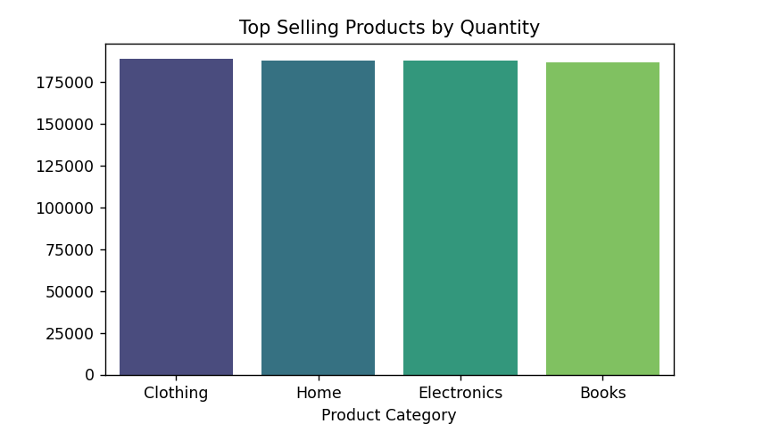

Top Categories Overview
Key Insights :
High and Consistent Sales: The chart reveals that all four product categories—Clothing, Home, Electronics, and Books—are top performers with very similar and high sales quantities.
Category Performance: All categories shown are strong performers, indicating broad customer demand across different product types.

Slide 5
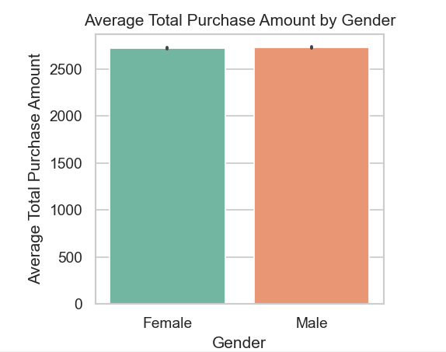

Gender Behaviors
Spending Patterns
Both genders exhibit similar spending habits, averaging around ₹2,700 per transaction. While this figure indicates parity in purchasing behavior, a slightly lower churn rate has been noted among male customers. This insight implies that men may be more loyal to brands, suggesting potential strategies for customer retention could benefit from tailored marketing approaches.

Slide 6

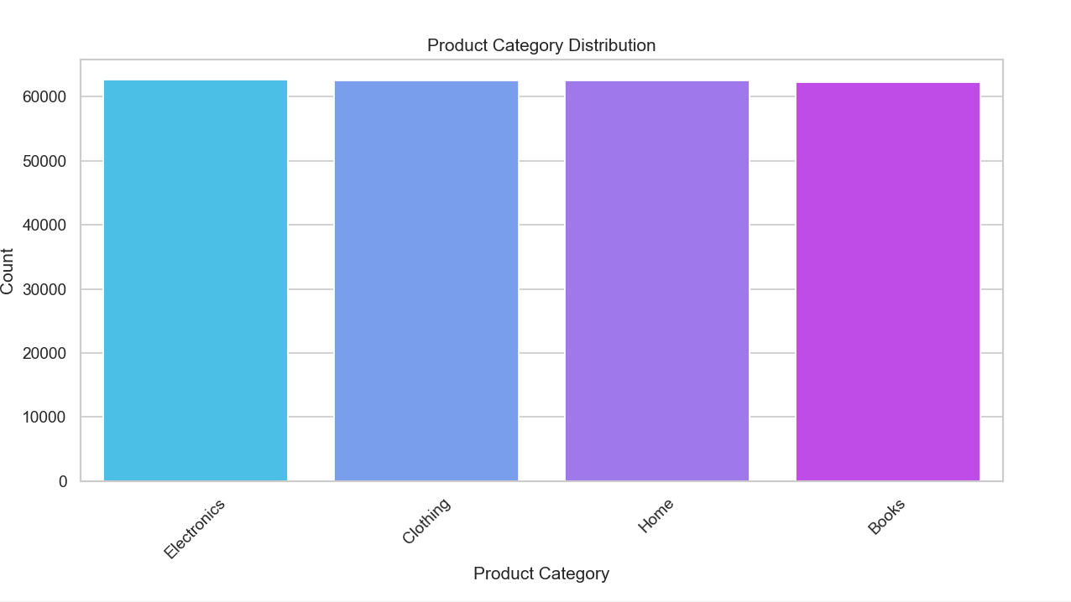
Product Category Distribution
1. Balanced Distribution: All four product categories—Electronics, Clothing, Home, and Books—have nearly identical counts, each around 62,000 transactions. This suggests a well-balanced product offering and customer interest across categories.
2. No Clear Dominance: None of the categories significantly outperforms or underperforms others in volume, which may imply a diverse and equally distributed customer base across different interests.
3. Uniform Engagement: Marketing, recommendation systems, or inventory strategies should consider all product categories equally, as none appears to require special attention based on volume alone.

Slide 7
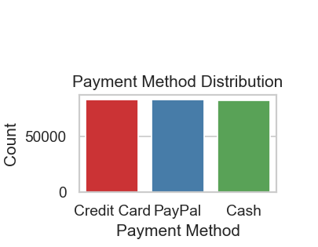
Preferred Payment Methods
Top Payment Methods
Digital Adoption
The leading payment methods among customers are Credit Cards, PayPal, and Cash. These options show varying strengths, catering to different preferences and transaction needs.
A strong trend in digital payments is evident, with over 66% of consumers favoring Credit Cards or PayPal. This reflects a shift towards modern and convenient payment solutions.

Slide 8

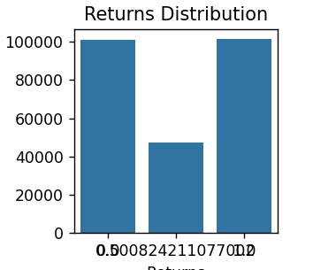
Return Rates Insights
Overall Return Rate
The overall return rate is around 50%, indicating a significant challenge in cost management and inventory control. Monitoring this metric is crucial for refining sales strategies and enhancing customer satisfaction.
Churn Patterns
Analysis shows that the lowest churn rates exist in Home and Electronics categories. Age segmentation reveals that customers aged 45–59 experience the least churn, while the youngest group, ages 18–24, shows the highest.

Slide 9
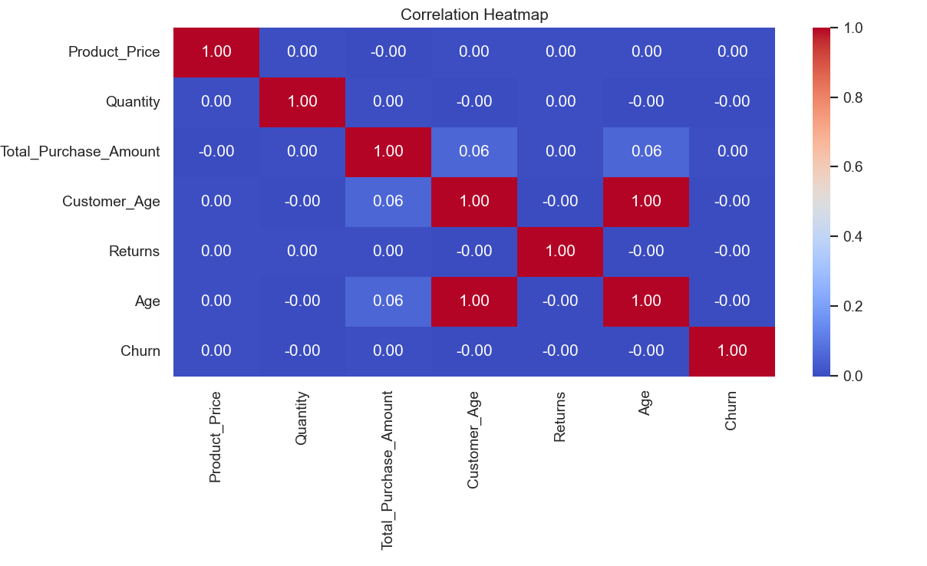
Numeric Correlation
Total Purchase Amount has low correlation with all variables:
Churn is not Correlated with any other feature.
Returns has no significant correlation with any variable.

Slide 10

Customer Demographics
This table summarizes spending behaviors and churn rates segmented by gender and age.
DEMOGRAPHIC | AVERAGE SPEND | CHURN RATE
Female | ₹2,700 | Moderate
Male | ₹2,700 | Lower
Age 18-24 | ₹2,000 | Highest
Age 45-59 | ₹3,200 | Lowest
Age 60+ | ₹3,000 | Low

Slide 11
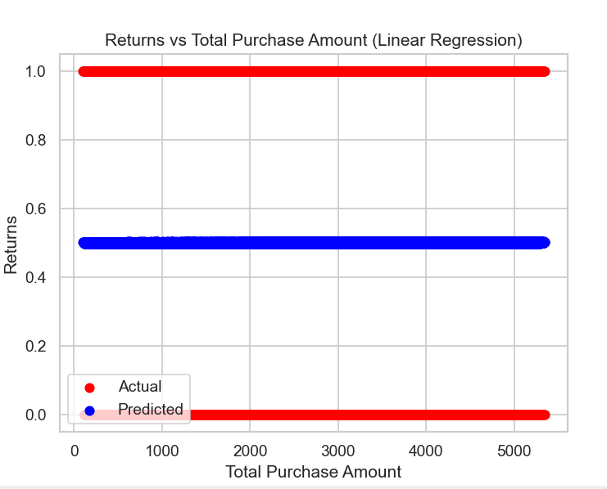
Linear Regression model
Insights :
The actual return values are binary (0 or 1), but linear regression outputs continuous values around 0.5.
The model fails to distinguish between returned and non-returned products.
Total Purchase Amount alone is not a strong predictor of returns.
Linear Regression is not suitable for binary outcomes — use Logistic Regression instead.

Slide 12
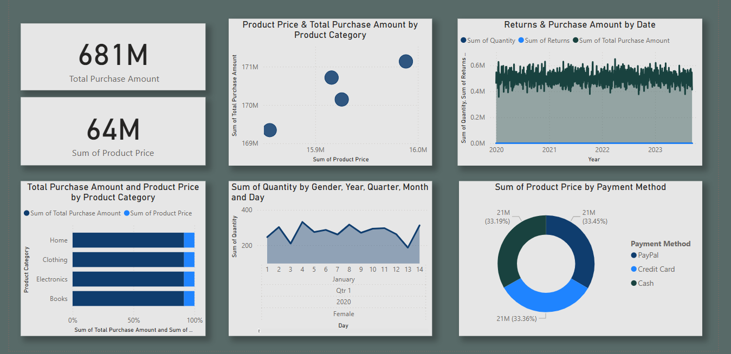
Data Visualization And Dashboard (Power Bi)

Slide 13

Recommendation
Optimize Return Policy
With a high return rate (~50%), review return reasons and introduce stricter return guidelines or better product descriptions to reduce unnecessary returns.
2. Implement Personalized Marketing
Use customer segmentation (age, gender, category preferences) to send tailored promotions and product recommendations to increase engagement.
3. Focus on High-Loyalty Segments
Target male customers and the 45–59 age group, who show lower churn rates, with loyalty programs and early access to deals to retain them longer.
4. Equal Category Promotion
As no single category dominates in sales or returns, maintain balanced promotional efforts across Electronics, Clothing, Home, and Books to maximize reach.
5. Enhance Digital Payment Experience
With over 66% of customers preferring digital payments, ensure a seamless and secure checkout process, and promote digital options with cashback or discounts.

Slide 14
THANK YOU

